Slide 1
PREDICT 422: Practical Machine Learning
Module 6:
Classification Models
Lecturer: Nathan Bastian, Section: XXX

Slide 2
Assignment
Reading: Ch. 4
Activity: Quiz 6, R Lab 6

Slide 3
References
An Introduction to Statistical Learning, with Applications in R (2013), by G. James, D. Witten, T. Hastie, and R. Tibshirani.
The Elements of Statistical Learning (2009), by T. Hastie, R. Tibshirani, and J. Friedman.

Slide 4
Lesson Goals:
Understand the basic setting of a classification problem.
Understand the Bayes classification rule.
Understand the statistical model of logistic regression.
Understand the binary logistic regression algorithm.
Understand the basic concepts of the multi-class logistic regression algorithm.
Understand the statistical model used by Linear Discriminant Analysis (LDA) and Quadratic Discriminant Analysis (QDA).
Understand how to estimate the Gaussian distributions within each class.
Understand the LDA and QDA classification rule.
Know the similarities and differences between LDA and logistic regression.
Understand the K-nearest neighbor classification algorithm.
Understand how the number of neighbors, K, adjusts the model complexity.
Understand the differences between all of the classification methods.

Slide 5
Classification
Predicting a qualitative response for an observation can be referred to as classifying that observation, since it involves assigning the observation to a category, or class.
Thus, classification models are supervised learning methods for which the true class labels for the data points are given in the training data.
The methods used for classification often predict the probability of each of the categories of a qualitative variable as the basis for making the classification decision.

Slide 6
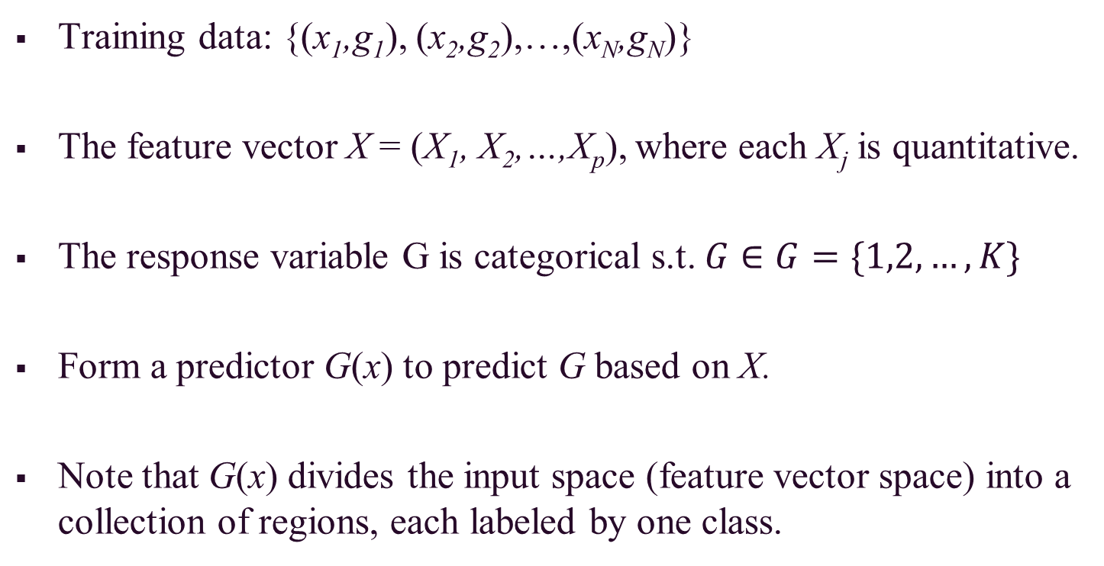
Classification Setting
Training data: {(x₁,g₁), (x₂,g₂),…,(x_{N},g_{N})}
The feature vector X = (X₁, X₂,…,X_{p}), where each X_{j} is quantitative.
The response variable G is categorical s.t. $G∈G=\{1,2,…,K\}$
Form a predictor G(x) to predict G based on X.
Note that G(x) divides the input space (feature vector space) into a collection of regions, each labeled by one class.

Slide 7
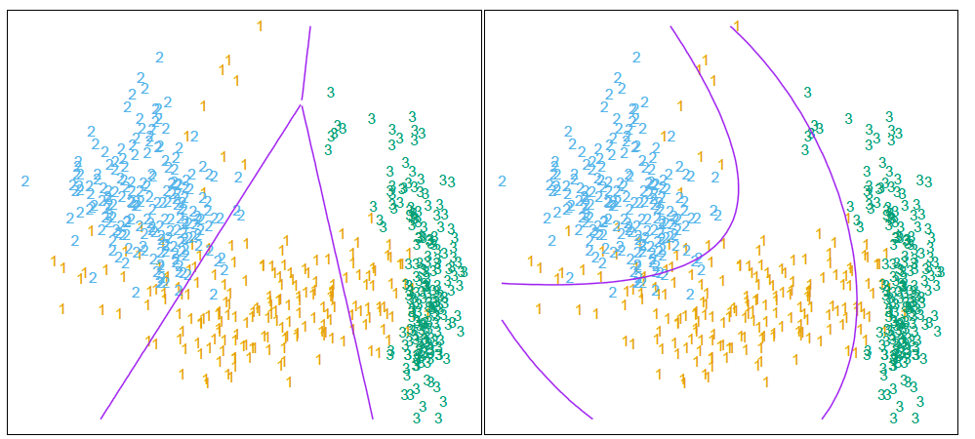
Classification Setting (cont.)
For each plot, the feature vector space is divided into three pieces, each assigned with a particular class.

Slide 8
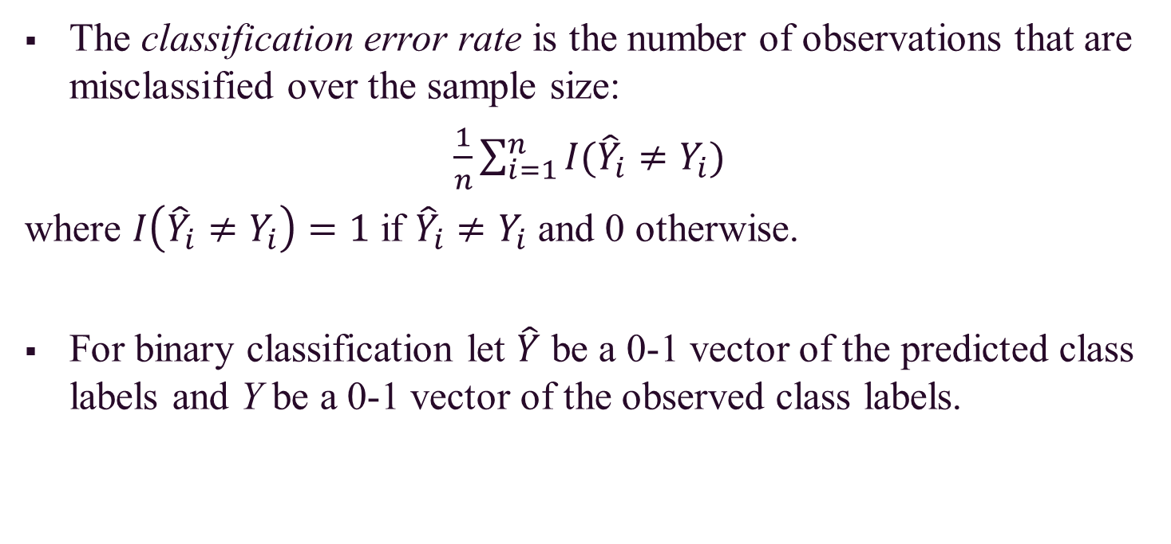
Classification Error Rate
The classification error rate is the number of observations that are misclassified over the sample size:
$\frac{1}{n}\sum_{i=1}^{n}{I({\hat{Y}}_{i}≠Y_{i})}$
where $I\left({\hat{Y}}_{i}≠Y_{i}\right)=1$ if ${\hat{Y}}_{i}≠Y_{i}$ and 0 otherwise.
For binary classification let $\hat{Y}$ be a 0-1 vector of the predicted class labels and Y be a 0-1 vector of the observed class labels.

Slide 9
Bayes Classification Rule
Suppose the marginal distribution of G is specified by the probability mass function p_{G}(g), g = 1, 2, ...,K.
The conditional distribution of X given G = g is f_{X|G}(x | G = g).
The training data (x_{i}, g_{i} ), i = 1, 2, ...,N, are independent samples from the joint distribution of X and G:
f_{X,G}(x,g) = p_{G}(g) f_{X|G}(x | G = g)

Slide 10
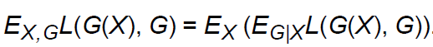
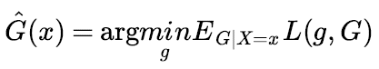
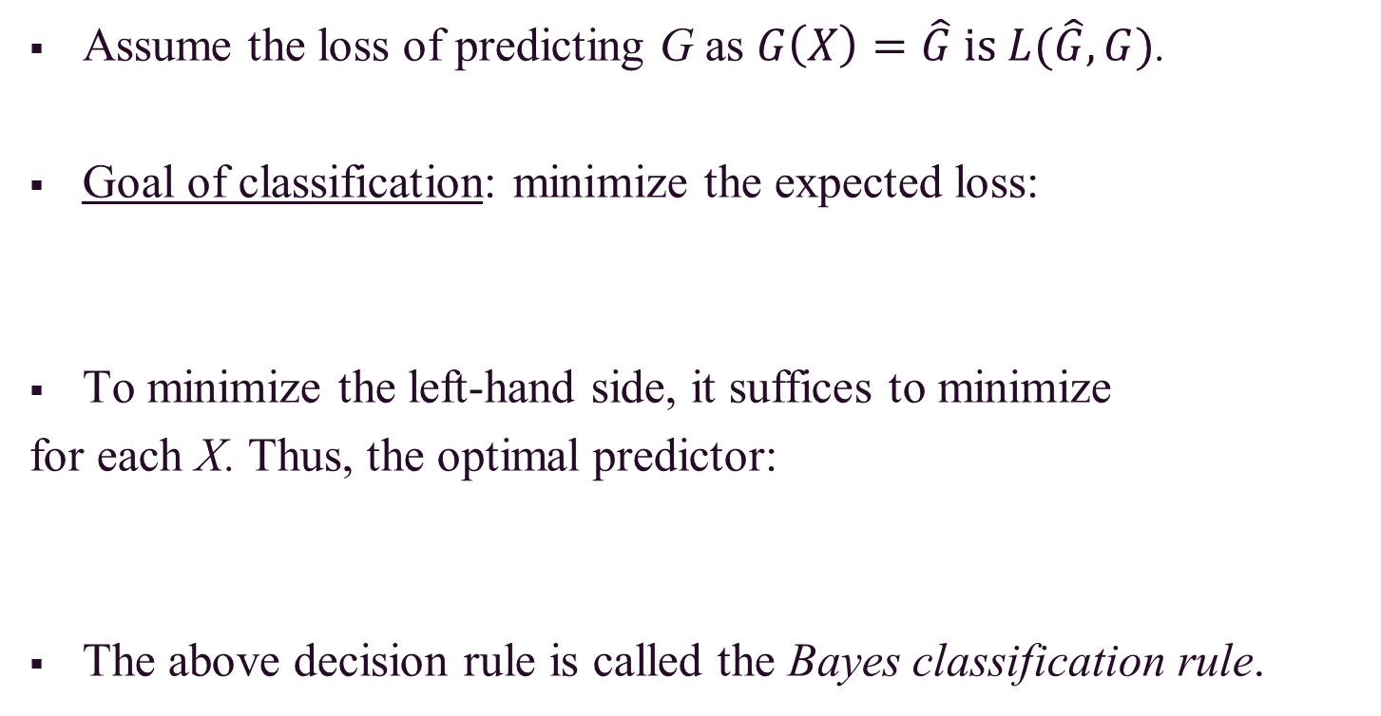
Bayes Classification Rule (cont.)
Assume the loss of predicting G as $G\left(X\right)=\hat{G} is L(\hat{G},G)$.
Goal of classification: minimize the expected loss:
To minimize the left-hand side, it suffices to minimize
for each X. Thus, the optimal predictor:
The above decision rule is called the Bayes classification rule.

Slide 11
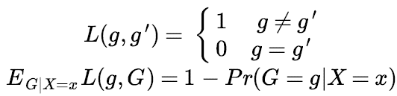
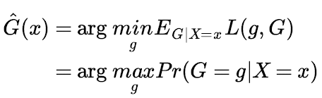
Bayes Classification Rule (cont.)
For 0-1 loss, i.e.
The Bayes rule becomes the rule of maximum posterior probability:
Many classification algorithms attempt to estimate Pr(G = g | X = x), then apply the Bayes rule.

Slide 12
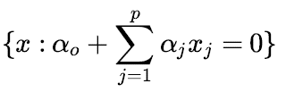
Linear Methods for Classification
Decision boundaries are linear.
Two class problem:
The decision boundary between the two classes is a hyperplane in the feature vector space,
A hyperplane in the p dimensional input space is the set:

Slide 13
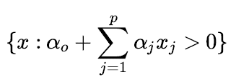
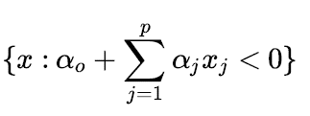
Linear Methods for Classification (cont.)
The two regions separated by a hyperplane:
For more than two classes, the decision boundary between any pair of classes k and I is a hyperplane.
Example methods for deciding the hyperplane:
Logistic regression
Linear discriminant analysis

Slide 14
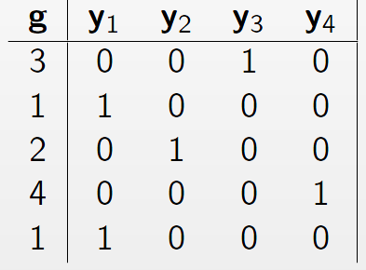
Can we use Linear Regression?
Here, each of the response categories are coded via an indicator variable (giving us an indicator response matrix).
If G has K classes, there will be K such indicators Y_{k}, k = 1,…,K.

Slide 15
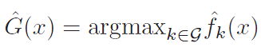
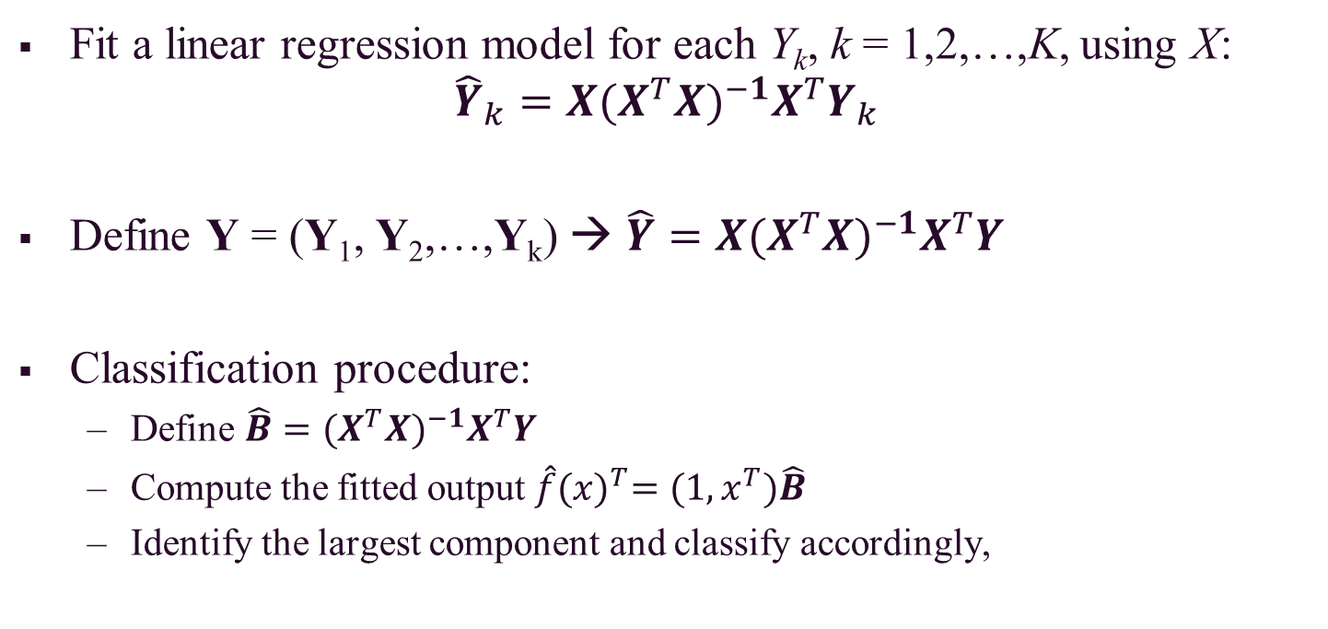
Can we use Linear Regression?
Fit a linear regression model for each Y_{k}, k = 1,2,…,K, using X:
$${\hat{Y}}_{k}=X{(X^{T}X)}^{−1}X^{T}Y_{k}$$
Define Y = (Y₁, Y₂,…,Y_{k}) → $\hat{Y}=X{(X^{T}X)}^{−1}X^{T}Y$
Classification procedure:
Define $\hat{B}={(X^{T}X)}^{−1}X^{T}Y$
Compute the fitted output $\hat{f}{(x)}^{T}=(1,x^{T})\hat{B}$
Identify the largest component and classify accordingly,

Slide 16
Can we use Linear Regression?
One rather formal justification is to view the linear regression as an estimate of conditional expectation.
However, how good an approximation to conditional expectation is the rather rigid linear regression model?
The key issue is that the fitted values can be negative or greater than 1; this is a consequence of the rigid nature of linear regression, especially if we make predictions outside the domain of the training data.

Slide 17
Can we use Linear Regression?
When Y only takes on values of 0 and 1, we can see why is OLS linear regression is often not appropriate.
0.9
How do we interpret values greater than 1?
0.7
Y
0.5
0.4
0.2
How do we interpret values of Y between 0 and 1?
0.0
.0
.1
.2
.3
.4
.5
.6
.7
.8
.9
1.0
X

Slide 18
Linear vs. Logistic Regression
Linear regression might produce probabilities less than zero or bigger than one because the regression line can take on any value between negative and positive infinity.
Thus, the regression line almost always predicts the wrong value for Y in classification problems.
Logistic regression is more appropriate, especially because we are interested in estimating the probabilities that X belong to each category, or class.

Slide 19
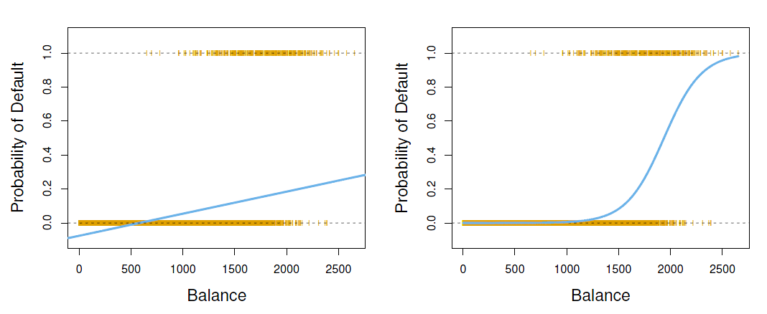
Linear vs. Logistic Regression (cont.)
Below, the orange marks indicate the response Y, either 0 or 1. Linear regression does not estimate Pr(Y = 1|X) well, so logistic regression seems well suited to the task.

Slide 20
Logistic Regression
There are two big branches of methods for classification. One is called generative modeling, and the other is called discriminative modeling.
Logistic regression for classification is a discriminative modeling approach, where we estimate the posterior probabilities of classes given X directly without assuming the marginal distribution on X.
As a result, this method preserves linear classification boundaries.

Slide 21
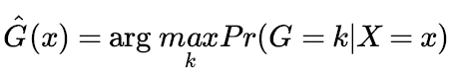
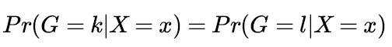
Logistic Regression (cont.)
A review of Bayes rule shows us that when we use 0-1 loss, we pick the class k that has the maximum posterior probability:
The decision boundary between classes k and l is determined by:
That is, the x’s at which the two posterior probabilities of k and l are equal.

Slide 22
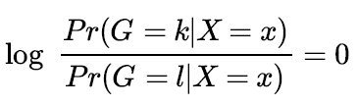
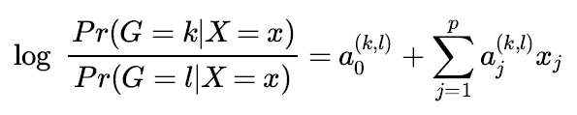
Logistic Regression (cont.)
If we divide both sides by Pr(G = l | X = x) and take the log of this ratio, the previous equation is equivalent to:
Since we want to enforce a linear classification boundary, we assume the function above is linear:
The is the basic assumption of logistic regression.

Slide 23
Logistic Regression (cont.)
We use the superscript (k, l) on the coefficients of the linear function because for every pair of k and l, the decision boundary would be different, determined by the different coefficients.
For logistic regression, there are restrictive relations between a^{(k,l)} for different pairs of (k, l).
We do not really need to specify this equation for every pair of k and l, but instead we only need to specify it for K – 1 such pairs.

Slide 24
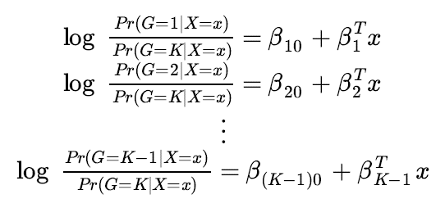
Logistic Regression (cont.)
If we take class K as the base class, the assumed equations are:
This indicates that we do not have to specify the decision boundary for every pair of classes. We only need to specify the decision boundary between class j and the base class K.

Slide 25
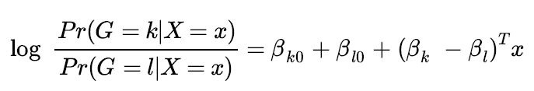
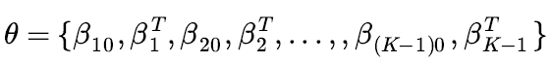
Logistic Regression (cont.)
Once we have specified the parameters for these K – 1 log ratios, then for any pair of classes (k, l), we can derive the log ratios without introducing new parameters:
Number of parameters: (K – 1)(p + 1)
We denote the entire parameter set by θ and arrange them as:

Slide 26
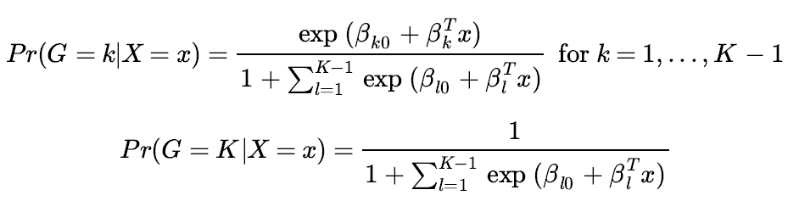
Logistic Regression (cont.)
The log ratios of posterior probabilities are called log-odds or logit transformations.
Under the previously stated assumptions, the posterior probabilities are given by the following two equations:

Slide 27
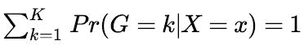
Logistic Regression (cont.)
For Pr(G = k | X = x) given previously:
These must sum to 1:
Similarities with linear regression on indicators:
Both attempt to estimate Pr(G = k | X = x), both have linear classification boundaries, and the posterior probabilities sum to 1 across classes
Differences with linear regression on indicators:
For linear regression, approximate Pr(G = k | X = x) by a linear function of x; it is not guaranteed to fall between 0 and 1.
For logistic regression, Pr(G = k | X = x) is a nonlinear (sigmoid) function of x; it is guaranteed to range from 0 to 1.

Slide 28
Logistic Regression (cont.)
How do we estimate the parameters and how do we fit a logistic regression model?
What we want to do is find parameters that maximize the conditional likelihood of class labels G given X using the training data.
We are not interested in the distribution of X, but our focus is on the conditional probabilities of the class labels given X.

Slide 29
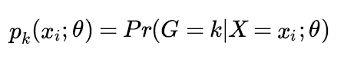
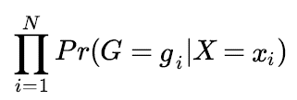
Logistic Regression (cont.)
Given point x_{i}, the posterior probability for the class to be k is:
Given the first input x₁, the posterior probability of its class, denoted as g₁, is computed by: Pr(G = g₁|X = x₁)
Since samples in the training data are summed independent, the posterior probability for the N sample points each have class g_{i}, I = 1,2,…,N, given their inputs x₁,x₂,…,x_{N} is:

Slide 30
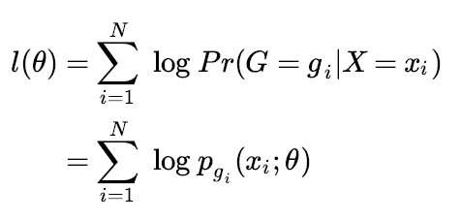
Logistic Regression (cont.)
The joint conditional likelihood is the product of the conditional probabilities of the classes given every data point.
Thus, the conditional log-likelihood of the class labels in the training data set becomes a summation:

Slide 31
Logistic Regression (cont.)
We discuss in detail the two-class case (i.e. binary classification), since the algorithms simplify considerably.
It is convenient to code the two-class g_{i} via a 0/1 response y_{i}, where y_{i} = 1 when g_{i} = class 1, and y_{i} = 0 when g_{i} = class 2.
Let p₁(x; θ) = p(x; θ) and let p₂(x; θ) = 1 - p₁(x; θ) = 1 - p(x; θ) because the posterior probabilities of the two classes must sum up to one.
Since K = 2, there is only one decision boundary between the two classes.

Slide 32
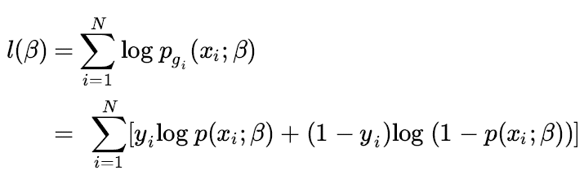
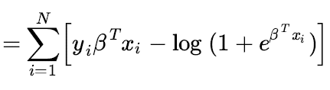
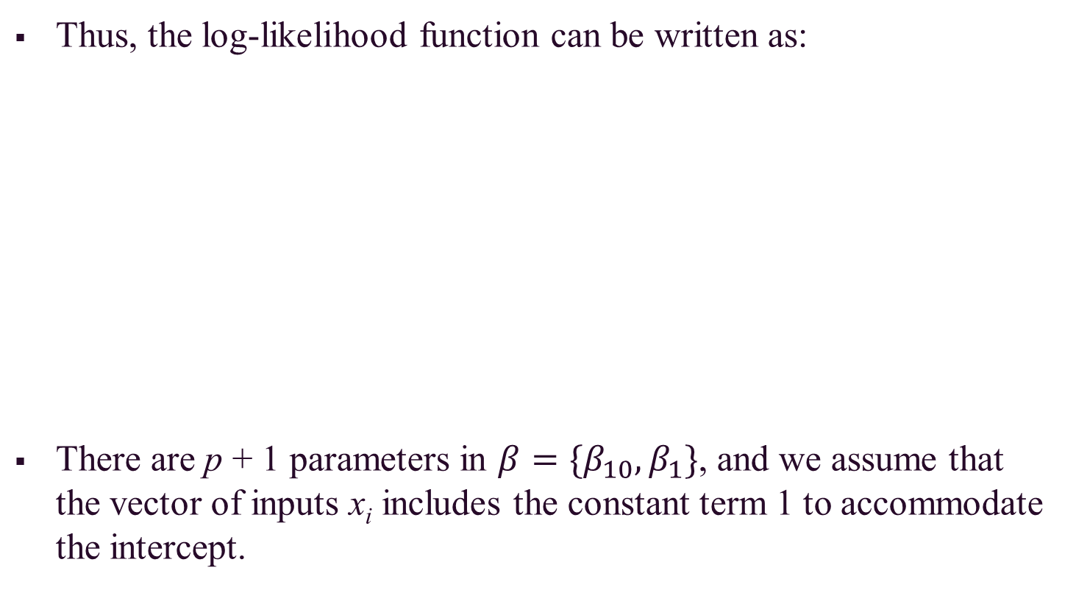
Logistic Regression (cont.)
Thus, the log-likelihood function can be written as:
There are p + 1 parameters in $β=\{β_{10},β_{1}\}$, and we assume that the vector of inputs x_{i} includes the constant term 1 to accommodate the intercept.

Slide 33
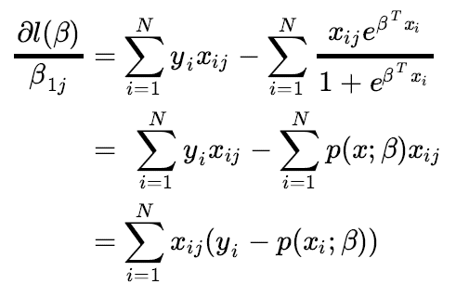
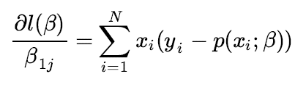
Logistic Regression (cont.)
If we want to maximize the log-likelihood function, we set the first order partial derivatives of the function l(β) with respect to β_{1j} to zero for all j = 0, 1,…., p:
In matrix form:

Slide 34
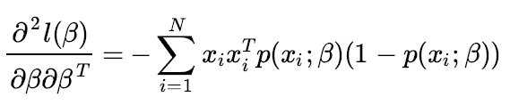
Logistic Regression (cont.)
To solve the set of p + 1 nonlinear equations, we use the Newton-Raphson algorithm.
This algorithm requires the second-order derivatives (i.e. Hessian matrix), given as follows:

Slide 35
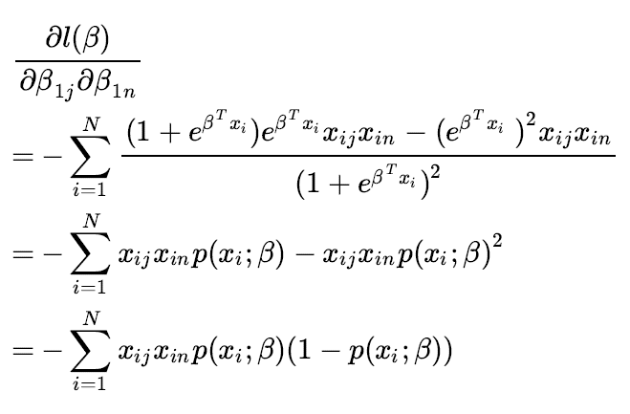
Logistic Regression (cont.)
We now derive the Hessian matrix, where the element on the jth row and nth column is (counting from 0):

Slide 36
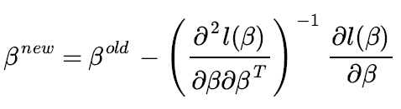
Logistic Regression (cont.)
Starting with β^{old}, a single Newton-Raphson update is given by this matrix formula:
where the derivatives are evaluated at β^{old}.
If given an old set of parameters, we update the new set of parameters by taking β^{old} minus the inverse of the Hessian matrix times the first-order derivative vector.

Slide 37
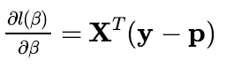
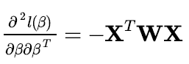
Logistic Regression (cont.)
This procedure can also be expressed compactly in matrix form.
Let y be the column vector of yi, let X be the N x (p + 1) input matrix, let p be the N-vector of fitted probabilities, and let W be an N x N diagonal matrix of weights.
Then, the first order derivative vector is:
The Hessian matrix is:

Slide 38
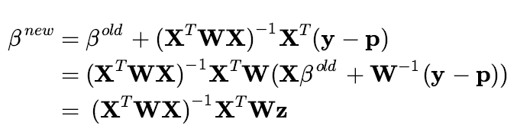
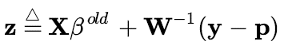
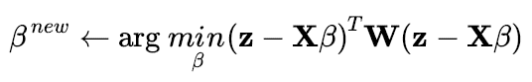
Logistic Regression (cont.)
The Newton-Raphson step is:
where
If z is viewed as a response and X is the input matrix, then β^{new} is the solution to a weighted least squares problem:

Slide 39
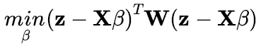
Logistic Regression (cont.)
Recall that linear regression by OLS solves:
Z is referred to as the adjusted response, and the algorithm is referred to as iteratively reweighted least squares (IRLS).
The pseudo code of a relative computationally efficient algorithm for IRLS is provided on the next slide.

Slide 40
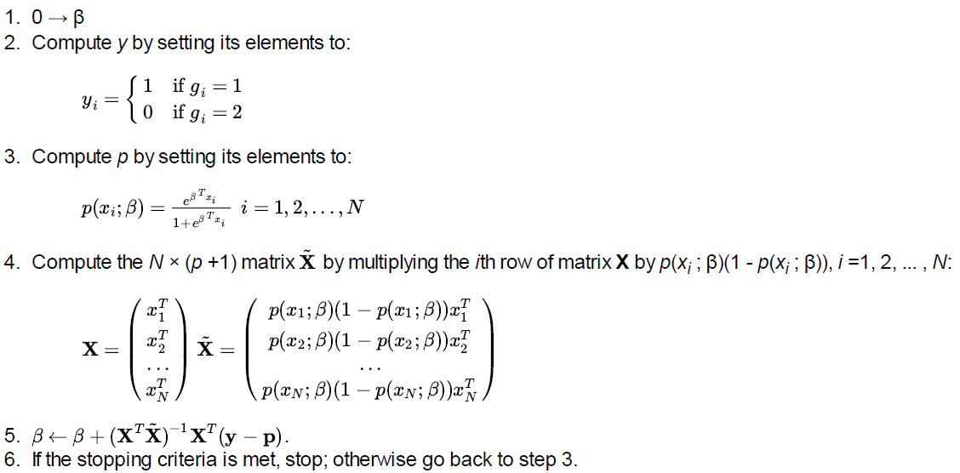
Logistic Regression (cont.)

Slide 41
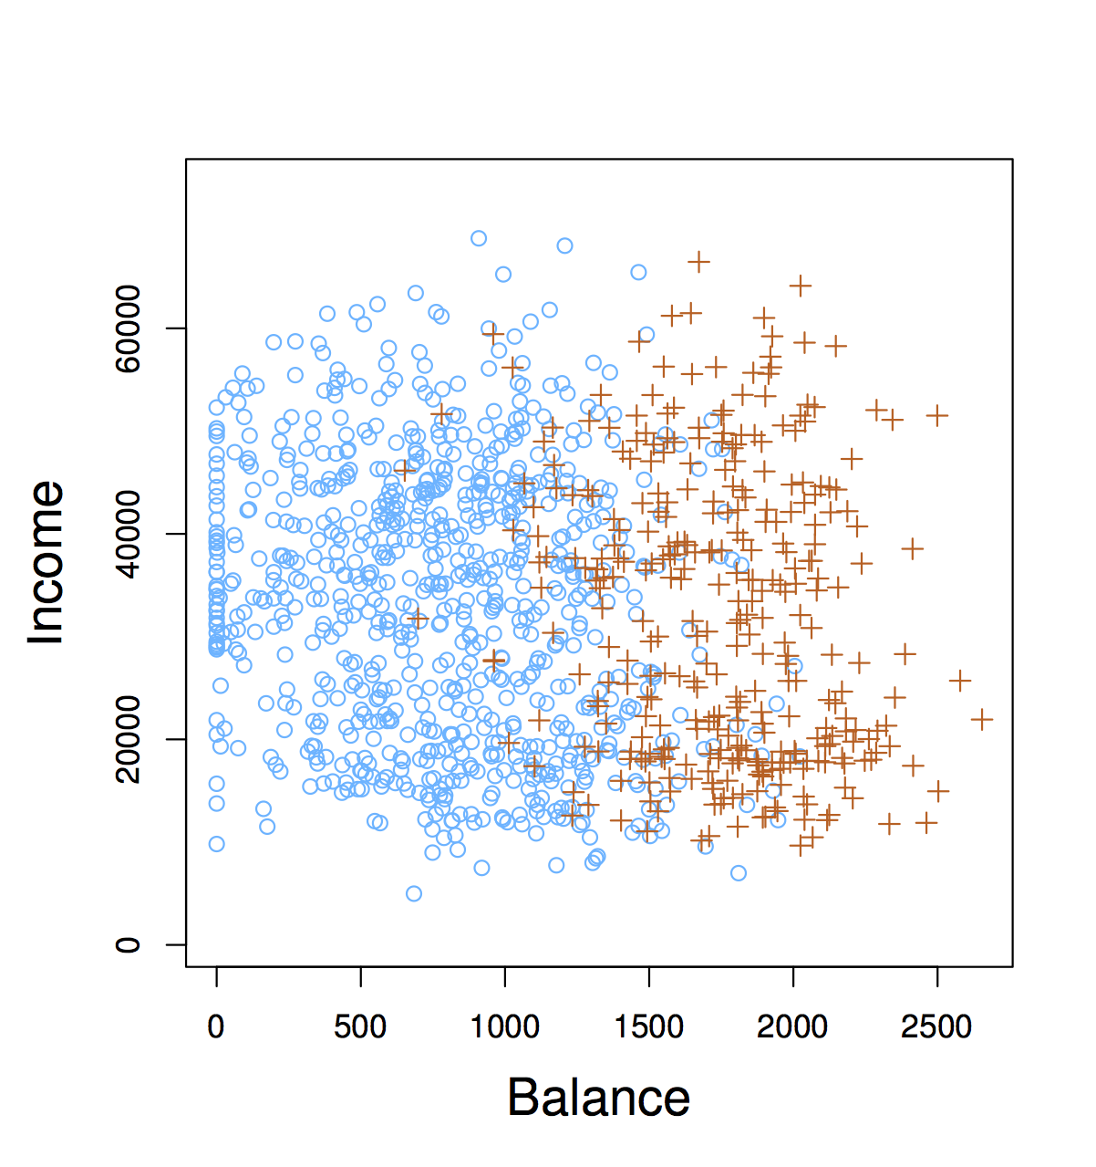
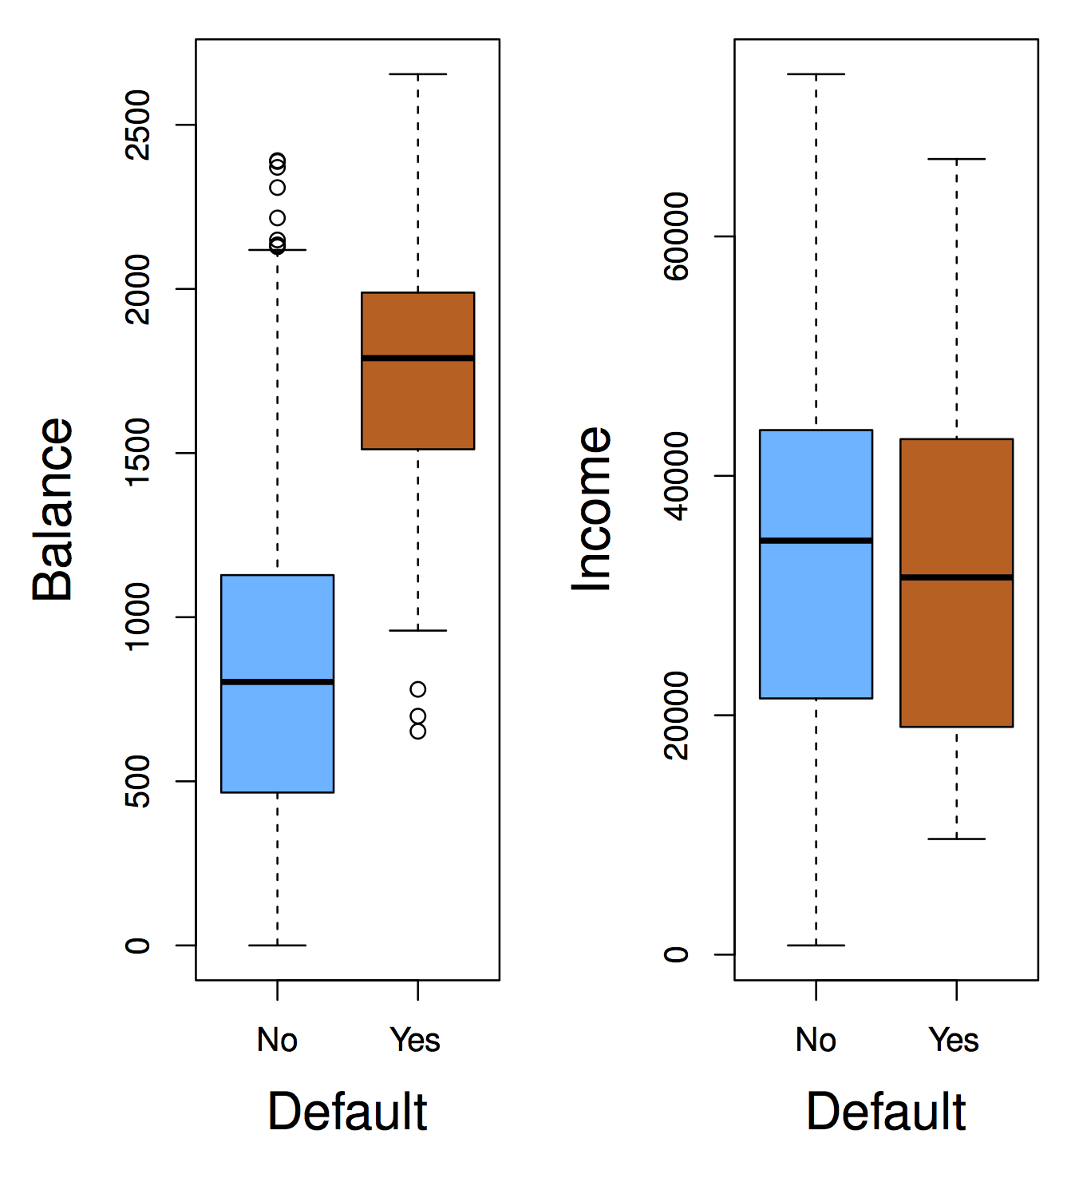
Logistic Regression: Credit Card Default Example
We would like to be able to predict customers that are likely to default on their credit card.
Possible X variables:
Annual Income
Monthly Credit Card Balance
The Y variable (Default) is categorical: Yes or No

Slide 42
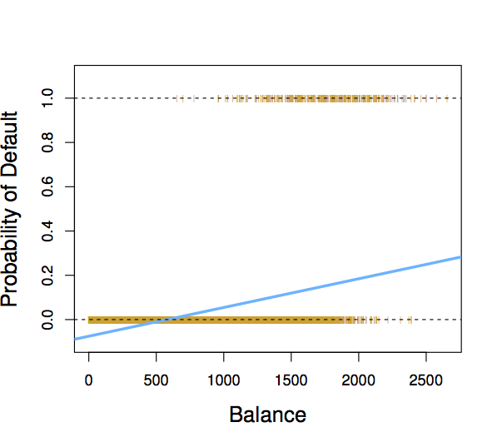
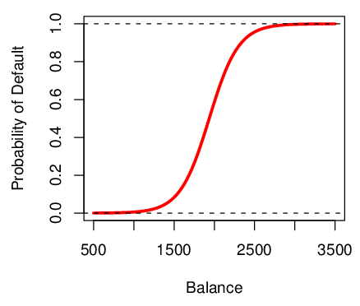
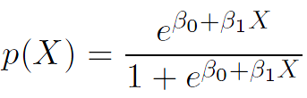
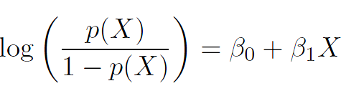
Logistic Regression: Credit Card Default Example (cont.)
If we fit a linear regression model to the Default data, then:
For very low balances we predict a negative probability!
For high balances we predict a probability above 1!
If we fit a logistic regression model, then the probability of default is between 0 and 1 for all balances.

Slide 43
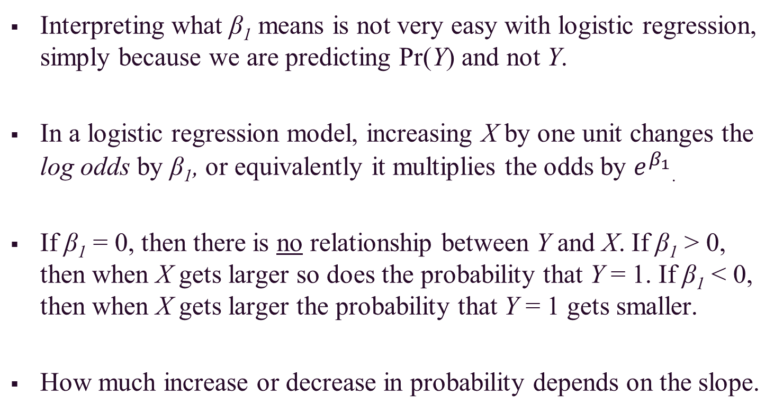
Logistic Regression: Credit Card Default Example (cont.)
Interpreting what β₁ means is not very easy with logistic regression, simply because we are predicting Pr(Y) and not Y.
In a logistic regression model, increasing X by one unit changes the log odds by β₁, or equivalently it multiplies the odds by $e^{β_{1}}$.
If β₁ = 0, then there is no relationship between Y and X. If β₁ > 0, then when X gets larger so does the probability that Y = 1. If β₁ < 0, then when X gets larger the probability that Y = 1 gets smaller.
How much increase or decrease in probability depends on the slope.

Slide 44
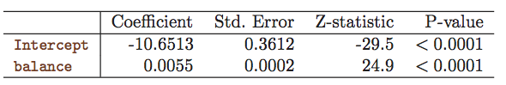

Logistic Regression: Credit Card Default Example (cont.)
We still want to perform a hypothesis test to see whether we can be sure that β₀ and β₁ are significantly different from zero.
We use a Z test and interpret the p-value as usual.
In this example, the p-value for balance is very small and ${\hat{β}}_{1}$ is positive. This means that if the balance increases, then the probability of default will increase as well.

Slide 45


Logistic Regression: Credit Card Default Example (cont.)
What is the estimated probability of default for someone with a balance of $1000?
What is the estimated probability of default for someone with a balance of $2000?

Slide 46

Logistic Regression: Credit Card Default Example (cont.)
We can also use student (0,1) as a predictor to estimate the probability that an individual defaults:

Slide 47

Multiple Logistic Regression
Note that we use the maximum likelihood method (as previously discussed) to estimate the beta coefficients when considering the problem of predicting a binary response using multiple predictors.

Slide 48

L₁ Regularized Logistic Regression
For logistic regression, we would maximize a penalized version of the log-likelihood function:
As with the lasso method, we typically do not penalize the intercept term, and we standardize the predictors for the penalty to be meaningful.
Because this optimization criterion is concave, a solution can be found using nonlinear programming methods or via quadratic approximations as used in the Newton-Raphson algorithm.

Slide 49
Multi-Class Logistic Regression
We sometimes wish to classify a response variable that has more than two classes.
The two-class logistic regression models have multiple class extensions.
This method is often not used in practice because discriminant analysis is a more popular method for multi-class classification.

Slide 50


Multi-Class Logistic Regression (cont.)
When the number of classes K > 2, the parameter β is a (K – 1)(p + 1) vector:
Also, let

Slide 51

Multi-Class Logistic Regression (cont.)
The log-likelihood function becomes:

Slide 52

Multi-Class Logistic Regression (cont.)
The indicator function I(.) equals 1 when the argument is true and 0 otherwise.
Thus, the first order derivatives of the log-likelihood function are:

Slide 53

Multi-Class Logistic Regression (cont.)
The second order derivatives of the log-likelihood function are:
We next express the solution in matrix form because it is much more compact. First, we introduce several notations.

Slide 54


Multi-Class Logistic Regression (cont.)
y is the concatenated indicator vector, a column vector of dimension N(K - 1).
p is the concatenated vector of fitted probabilities, a column vector of dimension N(K - 1).

Slide 55



Multi-Class Logistic Regression (cont.)
$\tilde{X}$ is an N(K - 1) x (p + 1)(K - 1) matrix, where X is the N(p + 1) input matrix defined before:
Matrix W is an N(K - 1) x N(K - 1) square matrix:

Slide 56

Multi-Class Logistic Regression (cont.)
Each submatrix W_{km}, 1 ≤ k, m ≤ K - 1, is an N x N diagonal matrix.
When k = m, the ith diagonal element in W_{kk} is p_{k}(x_{i}; β^{old})(1 - p_{k}(x_{i}; β^{old})).
– When k ≠ m, the ith diagonal element in W_{km} is -p_{k}(x_{i}; β^{old})(1 - p_{m}(x_{i}; β^{old})).
As with binary classification:

Slide 57

Multi-Class Logistic Regression (cont.)
The formula for updating β^{new} in the binary classification case holds for multi-class, except that the definitions of the matrices are more complicated.
The formula itself may look simple because the complexity is wrapped in the definitions of the matrices.

Slide 58
Discriminant Analysis
Let the feature vector be X and the class labels be Y.
The Bayes rule says that if you have the joint distribution of X and Y, and if X is given, under 0-1 loss, the optimal decision on Y is to choose a class with maximum posterior probability given X.
Discriminant analysis belongs to the branch of classification methods called generative modeling, where we try to estimate the within class density of X given the class label.
Combined with the prior probability (unconditioned probability) of classes, the posterior probability of Y can be obtained by the Bayes formula.

Slide 59


Discriminant Analysis (cont.)
Assume the prior probability or the marginal probability mass function for class k is denoted as $π_{k}, \sum_{k=1}^{K}{π_{k}=1}$
$π_{k}$ is the probability that a given observation is associated with the kth category of the response variable Y.
Note that $π_{k}$ is usually estimated simply by empirical frequencies of the training set:

Slide 60

Discriminant Analysis (cont.)
You have the training data set and you count what percentage of data come from a certain class.
Then we need the class-conditional density of X.
This is the density function of X conditioned on the class k, or class G = k denoted by f_{k}(x).
Note that f_{k}(x) is relatively large if there is a high probability that an observation in the kth class has $X≈x$, and f_{k}(x) is relatively small if it is very unlikely that an observation in the kth class has $X≈x$.

Slide 61


Discriminant Analysis (cont.)
According to the Bayes rule, we can now compute the posterior probability that an observation X = x belongs to the kth class:
This is a conditional probability of class G (or denoted Y in the book) given X (the predictor value for that observation).
By the Bayes rule for 0-1 loss:

Slide 62
Discriminant Analysis (cont.)
Notice that the denominator is identical no matter what class k you are using. Thus, for maximization, it does not make a difference in the choice of k.
The maximum a posteriori rule (i.e. Bayes rule for 0-1 loss) is essentially trying to maximize π_{k} times f_{k}(x).
Note that the Bayes classifier, which classifies an observation to the class for which the posterior probability is largest, has the lowest possible error rate out of all classifiers.

Slide 63
Class Density Estimation
Depending on which algorithms you use, you end up with different ways of density estimation within every class.
In both Linear Discriminant Analysis (LDA) and Quadratic Discriminant Analysis (QDA), we assume that every density within each class is a Gaussian distribution.
In LDA we assume those Gaussian distributions for different classes share the same covariance structure. In QDA, however, we do not have such a constraint.

Slide 64
Class Density Estimation (cont.)
You can also use general nonparametric density estimates, for instance kernel estimates and histograms.
Naive Bayes: assume each of the class densities are products of marginal densities, that is, all the variables are independent.
In the well-known Naive Bayes algorithm, you can separately estimate the density (or probability mass function for discrete values of X) for every dimension and then multiply them to get the joint density (or joint probability mass function).

Slide 65
Linear Discriminant Analysis
LDA undertakes the same task as logistic regression in that it classifies data based on categorical variables.
When the classes are well separated, the parameter estimates for the logistic regression model are surprisingly unstable, where LDA does not suffer from this problem.
Under LDA, we assume that the density for X given every class k is following a Gaussian distribution.

Slide 66


Linear Discriminant Analysis (cont.)
The following is the density formula for a multivariate Gaussian distribution:
where p is the dimension and $Σ_{k}$ is the covariance matrix.
This involves the square root of the determinant of this matrix. In this case, we are doing matrix multiplication.
The vector x and the mean vector μ_{k} are both column vectors.

Slide 67

Linear Discriminant Analysis (cont.)
For LDA, the covariance matrix $Σ_{k}=Σ ∀ k$
In LDA, you simply assume for different k that the covariance matrix is identical.
By making this assumption, the classifier becomes linear. The only difference from QDA is that we do not assume that the covariance matrix is identical for different classes.
For QDA, the decision boundary is determined by a quadratic function.

Slide 68



Linear Discriminant Analysis (cont.)
Since the covariance matrix determines the shape of the Gaussian density, in LDA, the Gaussian densities for different classes have the same shape, but are shifted versions of each other (different mean vectors).

Slide 69
Linear Discriminant Analysis (cont.)
For the moment, we will assume that we already have the covariance matrix for every class.
In terms of optimal classification, Bayes rule says that we should pick a class that has the maximum posterior probability given the feature vector X.
If we are using the generative modeling approach, this is equivalent to maximizing the product of the prior and the within class density.

Slide 70

Linear Discriminant Analysis (cont.)
Since the log function is an increasing function, the maximization is equivalent because whatever gives you the maximum should also give you a maximum under a log function.
Thus, we plug in the density of the Gaussian distribution assuming common covariance and then multiplying the prior probabilities:

Slide 71


Linear Discriminant Analysis (cont.)
Note that:
After simplification, we obtain the Bayes classifier:
Given any x, you simply plug into this formula and see which k maximizes this.
Usually the number of classes is pretty small, and very often only two classes, so an exhaustive search over the classes is effective.

Slide 72


Linear Discriminant Analysis (cont.)
LDA provides a linear boundary because the quadratic term is dropped.
Thus, we define the linear discriminant function as:
The decision boundary between class k and l is
or equivalently

Slide 73


Linear Discriminant Analysis (cont.)
In binary classification, for instance if we let (k = 1, l = 2), then we would define constant a₀, where π₁ and π₂ are prior probabilities for the two classes and μ₁ and μ₂ are mean vectors.
Define:
Define:
Classify to class 1 if or to class 2 otherwise.

Slide 74


Linear Discriminant Analysis (cont.)
For example:
We have two classes and we know the within class density. The marginal density is simply the weighted sum of the within class densities, where the weights are the prior probabilities.
Decision Boundary

Slide 75
Linear Discriminant Analysis (cont.)
Because we have equal weights and because the covariance matrix two classes are identical, we get these symmetric lines in the contour plot.
The black diagonal line is the decision boundary for the two classes.
If you are given an x, if it is above the line we would be classifying this x into the first-class. If it is below the line, it would be classified into the second class.

Slide 76
Linear Discriminant Analysis (cont.)
In this example, we assumed that we have the prior probabilities for the classes and we also had the within class densities given to us.
In practice, however, we do not have this. All we have is a set of training data.
Thus, how do we find the π_{k}’s and the f_{k}(x)?
We need to estimate the Gaussian distribution!!

Slide 77

Linear Discriminant Analysis (cont.)
Here is the formula for estimating the π_{k} 's and the parameters in the Gaussian distributions.
The formula below is actually the maximum likelihood estimator:
where N_{k} is the number of class-k samples and N is the total number of points in the training data.
To get the prior probabilities for class k, we simply count the frequency of data points in class k.

Slide 78

Linear Discriminant Analysis (cont.)
The mean vector for every class is also simple. We take all of the data points in a given class and compute the sample mean:
The covariance matrix formula looks slightly complicated. The reason is because we have to get a common covariance matrix for all of the classes.
First, we divide the data points in two given classes according to the given labels.

Slide 79

Linear Discriminant Analysis (cont.)
If we were looking at class k, for every point we subtract the corresponding mean which we computed earlier. Then multiply its transpose.
Remember x is a column vector, therefore if we have a column vector multiplied by a row vector, we get a square matrix, which is what we need.

Slide 80
Linear Discriminant Analysis (cont.)
First, we do the summation within every class k, then we have the sum over all of the classes. Next, we normalize by the scalar quantity, N - K.
When we fit a MLE it should be divided by N, but if it is divided by N – K, we get an unbiased estimator.
Remember, K is the number of classes. So, when N is large, the difference between N and N - K is pretty small.
Note that x^{(i)} denotes the ith sample vector.

Slide 81

LDA: Example
Suppose we have only one predictor (p = 1), and two normal density functions f₁(x) and f₂(x), represent two distinct classes.
The two density functions overlap, so there is some uncertainty about the class to which an observation with an unknown class belongs.
LDA Decision Boundary
Bayes Decision Boundary

Slide 82

LDA: Example (cont.)
If X is multidimensional where p = 2 and K = 3 classes:

Slide 83


LDA: Example (cont.)
Using Fisher’s Iris data set, we have:
4 variables (sepal length, sepal width, petal length, petal width)
3 species (setosa, versicolor, virginica)
50 samples per class
LDA correctly classifies all but 3 out of the 150 training samples.

Slide 84

Performance of a Classifier
LDA is trying the approximate the Bayes classifier, which has the lowest total error rate out of all classifiers (if the Gaussian model is correct).
In other words, the Bayes classifier will yield smallest possible total number of misclassified observations, irrespective of which class the errors come from.
Example of confusion matrix:

Slide 85
Performance of a Classifier (cont.)
Note that the results in the confusion matrix depend upon the establish threshold value, which is used to perform the classification based on the posterior probability.
The receiver operating characteristics (ROC) curve is a popular graphic for simultaneously displaying the two types of errors for all possible thresholds.
The overall performance of a classifier, summarized over all possible thresholds, is given by the area under the ROC curve.
The larger the area under the curve, the better the classifier!

Slide 86


Performance of a Classifier (cont.)
http://en.wikipedia.org/wiki/Sensitivity_and_specificity

Slide 87

Quadratic Discriminant Analysis
QDA is not much different from LDA except that you assume that the covariance matrix can be different foreach class.
Thus, we will estimate the covariance matrix Σ_{k} separately for each class k, k =1, 2, ... , K.
We get the following quadratic discriminant function:

Slide 88

Quadratic Discriminant Analysis (cont.)
This quadratic discriminant function is very much like the linear discriminant function except that because Σ_{k} is not identical, you cannot throw away the quadratic terms.
This discriminant function is a quadratic function and will contain second order terms.
We get the following classification rule:

Slide 89
Quadratic Discriminant Analysis (cont.)
For the classification rule, we find the class k which maximizes the quadratic discriminant function. The decision boundaries are quadratic equations in x.
QDA, because it allows for more flexibility for the covariance matrix, tends to fit the data better than LDA, but then it has more parameters to estimate.
The number of parameters increases significantly with QDA because of the separate covariance matrix for every class. If we have many classes and not so many sample points, this can be a problem.

Slide 90
Quadratic Discriminant Analysis (cont.)
As a result, there are trade-offs between fitting the training data well and having a simple model to work with.
A simple model sometimes fits the data just as well as a complicated model.
Even if the simple model does not fit the training data as well as a complex model, it still might be better on the test data because it is more robust.

Slide 91

LDA versus QDA
LDA is better!
QDA is better!
LDA Boundary
QDA Boundary
Bayes
Boundary

Slide 92

Naive Bayes
Assumes features are independent in each class.
This is useful when p is large, and so multivariate methods like QDA and even LDA break down!
Gaussian Naive Bayes assumes that each Σ_{k} is diagonal:
We can use for mixed feature vectors (qualitative and quantitative).

Slide 93

LDA and Logistic Regression
Under the model of LDA, we can compute the log-odds:
The model of LDA satisfies the assumption of the linear logistic model.

Slide 94

LDA and Logistic Regression (cont.)
The difference between linear logistic regression and LDA is that the linear logistic model only specifies the conditional distribution Pr(G = k | X = x).
No assumption is made about Pr(X), while the LDA model specifies the joint distribution of X and G.
Pr(X) is a mixture of Gaussians (where ϕ is the Gaussian density function):

Slide 95
LDA and Logistic Regression (cont.)
Moreover, linear logistic regression is solved by maximizing the conditional likelihood of G given X: Pr(G = k | X = x), while LDA maximizes the joint likelihood of G and X: Pr(X = x, G = k).
If the additional assumption made by LDA is appropriate, LDA tends to estimate the parameters more efficiently by using more information about the data.
Another advantage of LDA is that samples without class labels can be used under the model of LDA. On the other hand, LDA is not robust to gross outliers.
Because logistic regression relies on fewer assumptions, it seems to be more robust to non-Gaussian type of data.

Slide 96


Review: K-Nearest Neighbors
These classifiers are memory-based and require no model to be fit.
Training data:
Define distance on input x (e.g. Euclidian distance)
Classify new instance by looking at the label of the single closest sample in the training set:

Slide 97
Review: K-Nearest Neighbors (cont.)
By looking at only the closest sample, overfitting the data can be a huge problem.
To prevent overfitting, we can smooth the decision boundary by K nearest neighbors instead of 1.
Find the K training samples x_{r}, r = 1,…,K closest in distance to x*, and then classify using majority vote among the k neighbors.
The amount of computation can be intense when the training data is large since the distance between a new data point and every training point has to be computed and sorted.

Slide 98
Review: K-Nearest Neighbors (cont.)
Feature standardization is often performed in pre-processing.
Because standardization affects the distance, if one wants the features to play a similar role in determining the distance, standardization is recommended.
However, whether to apply normalization is rather subjective.
One has to decide on an individual basis for the problem in consideration.

Slide 99


Review: K-Nearest Neighbors (cont.)
The only parameter that can adjust the complexity of KNN is the number of neighbors k.
The larger k is, the smoother the classification boundary. Or we can think of the complexity of KNN as lower when k increases.
KNN
Decision Boundary
Bayes Decision Boundary

Slide 100

Review: K-Nearest Neighbors (cont.)
For another simulated data set, there are two classes. The error rates based on the training data, test data, and 10-fold cross validation are plotted against K, the number of neighbors.
We can see that the training error rate tends to grow when k grows, which is not the case for the error rate based on a separate test data set or cross-validation.

Slide 101
Comparison of Classification Methods
KNN is completely non-parametric, as there are no assumptions made about the shape of the decision boundary.
We can expect KNN to dominate both LDA and logistic regression when the decision boundary is highly non-linear.
On the other hand, KNN does not tell us which predictors are important; there is no table of coefficients.
QDA serves as a compromise between the non-parametric KNN method and the linear LDA and logistic regression approaches.

Slide 102
Comparison of Classification Methods
Logistic regression is very popular for classification, especially when K = 2.
LDA is useful when n is small, the classes are well separated (and Gaussian assumptions are reasonable), and when K > 2.
Finally, Naive Bayes is useful when p is very large.

Slide 103
Summary
Basic setting of a classification problem.
Bayes classification rule.
Statistical model of logistic regression.
Binary logistic regression algorithm.
Basic concepts of the multi-class logistic regression algorithm.
Statistical model used by LDA and QDA.
Estimate the Gaussian distributions within each class.
LDA and QDA classification rule.
Similarities and differences between LDA and logistic regression.
Review of the K-nearest neighbor classification algorithm.
How the number of neighbors, K, adjusts the model complexity.
Differences between all of the classification methods.

